Slide 1

Department of Information Technology
NBA Accredited A.P. Shah Institute of Technology G. B. Road, Kasarvadavli, Thane(W), Mumbai-400615 UNIVERSITY OF MUMBAI Academic Year 2021-2022

Slide 2
A Project Report on An IOT based framework for Statistical Analysis and Screening of Covid-19
Submitted in partial fulfillment of the degree of Bachelor of Engineering(Sem-8) in INFORMATION TECHNOLOGY By Pratik Gholap (18104070) Apoorva Gadkari (18104043) Priyanka Walekar (19204008) Under the Guidance of Dr. Utttam Kolekar
Co-Guide
Asst.Prof. Sonal Jain

Slide 3
1.Project Conception and Initiation

Slide 4
1.1 Abstract
COVID-19 has become a part of everyone's life whether we like it or no. Even though scientists and experts are trying their best to deliver vaccines to the public and they have also been successful in doing so, it is not practically possible that vaccines will be taken by each and every individual. There are other ways to detect this disease but it is either not 100% accurate or it takes a lot of time to give the result.

Slide 5
1.1 Abstract
A low-power wireless respiratory monitoring system for cough detection is proposed to detect various parameters that are required for the overall detection of this illness of peoples health. Further, this data will be processed on Raspberry Pi Model 3B+ where Support Vector Machine algorithm will be performed and send the prediction of the disease on the application as a conclusive Solution
Also, this data will be displayed over the website in the form of a dataset that can be used for future studies. The proposed system will always be used when a person comes outside from the house as a precaution and it can be used for actual patient monitoring and thus can be used for effective analysis and detection of this illness.

Slide 6
1.2 Objectives
To measure Oxygen Rate, Pulse Rate, Cough and Body Temperature using IOT Hardware Framework.
Collect the measured data and perform a Support Vector Machine Algorithm on Cloud to predict the diseases.
Display the predicted output on the Android Application also gets some basic detail to complete the sort of data that can be used further for studying.
Display the complete data on the website from where it can be accessed for study in different formats.

Slide 7
1.3 Literature Review
Sr No. | Paper Title | Authors | Outcomes
1. | Web-based patient health monitoring system using Raspberry Pi, IEEE, 04 May 2017 | Dhiraj Sunehra, Pini Ramakrishna | Various basic human physiological parameters such as pressure, heart rate, blood oxygen saturation (SPO2), body temperature, and fall detection are measured by relevant sensors and sent to the plate Arduino microcontroller to continue the process.
2. | An IOT Based Patient Monitoring System using Raspberry Pi, IEEE, 31 October 2016. | R.Kumar, Dr.M.Pallikonda Rajasekaran | Temperature, breathing, patient movements, and heart rate readings are monitored. The signals from these sensors are sent to the Raspberry Pi via the amplifier circuit and the signal learning unit (SCU) due to the low signal level (amplification). Therefore the amplifier circuit is used to generate the signal and to transmit the signals to the Raspberry Pi

Slide 8
1.3 Literature Review
Sr No. | Paper Title | Authors | Outcomes
3. | Healthcare based on IoT using Raspberry Pi, IEEE, 14 January 2016. | M. Surya Deekshith Gupta, Vamsikrishna Patchava, Virginia Menezes | The heartbeat is in the traditional range, monitoring continues. Sends alert to the authorized person by sending SMS via GSM.
4. | Portable electrocardiogram sensor monitoring system based on body area network, IEEE, 28 July 2016. | M. Udin Harun Al Rasyid, Alif Akbar Pranata, Bih-Hwang Lee, Ferry Astika Saputra, Amang Sudarsono | The device measures the graphical protocol signals continuously and therefore the signals are recorded by the e-Health device. These values represent the square of the USB cable streamed to a Raspberry Pi for victimization. The minicomputer processes the information and displays the value on the monitor like a terminal console. together they show diagrams corresponding to these ECG values.

Slide 9
1.3 Literature Review
Sr No. | Paper Title | Authors | Outcomes
5. | Wearable for Safety-Aware Mobility During Pandemic Outbreak. IEEE Consum. Electron. Mag. 2020, 9, 57–61 | Tripathy, A.K.; Mohapatra, A.G.; Mohanty, S.P.; Kougianos, E.; Joshi, A.M.; Das, G. EasyBand | The Author has discussed on the device helps in alerting for social distancing by auto contact tracing technology which will also help in limiting the growth of the virus. The overview of the system architecture is present in the paper, How it will be working in the tight area and loose contact.
6. | Low-Cost Contact Thermometry for Screening and Monitoring during the COVID-19 Pandemic. In Proceedings of the 2020 IEEE International IOT, Electronics and Mechatronics Conference (IEMTRONICS), Vancouver, BC, Canada, 9–12 September 2020; pp. 1–6. | Yamanoor, N.S. | The author has discussed the device which can be used for monitoring temperature using MAX30205 sensor embedded with the Arduino in the form for small band by making consideration on Low-Cost Modelling.

Slide 10
1.4 Problem Definition
Problem Identified
Testing results take time
Some tests are not that accurate
It is not possible that everyone has taken the vaccine
Proposed Solution
The aim is to develop an screening of patients with various sensors like LM35 and pulse rate sensor to make a statistical data of that patient and predict whether he/she has covid-19 or not that is faster and more accurate than RT-PCR test

Slide 11
1.5 Scope
Dataset which are generated are helpful for further studies.
Use of this compact device is preferrable instead of using individual machine.
Different disease can be develop other than Covid-19 detection.

Slide 12
1.6 Technology Stack
Hardware Module
Arduino Uno
LM35 temperature sensor
Oximeter, Heart Rate Sensor(HBTV2)
Push button10k Resistor
Male-female wires
Breadboard

Slide 13
1.6 Technology Stack
Mobile Application
SQL Database
Android Studio
Flask Framework
Website
HTML
CSS
Python Flask
SQL Database

Slide 14
1.7 Benefits for Environment & Society
It will help common people to test the vitals and keep check on it regularly.
It will help hospitals to measure this factors using compact device, and getting the data in place.
It will help us to generate mass data.
The dataset can help in further studies of different diagnostics.

Slide 15
2. Project Design

Slide 16
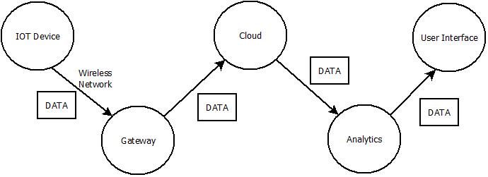
2.1 Proposed System

Slide 17
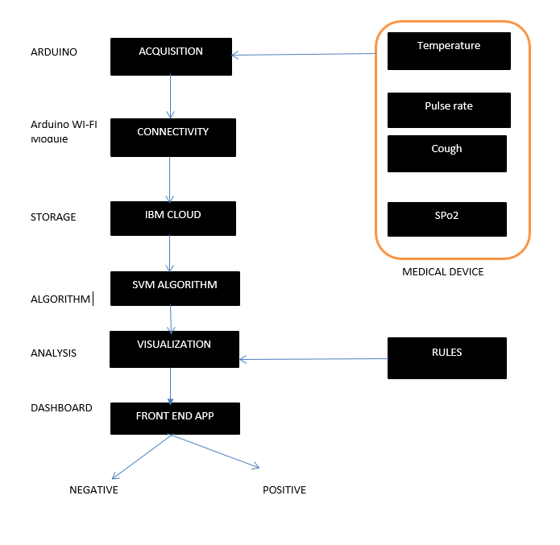
2.2 Design(Flow Of Modules)

Slide 18
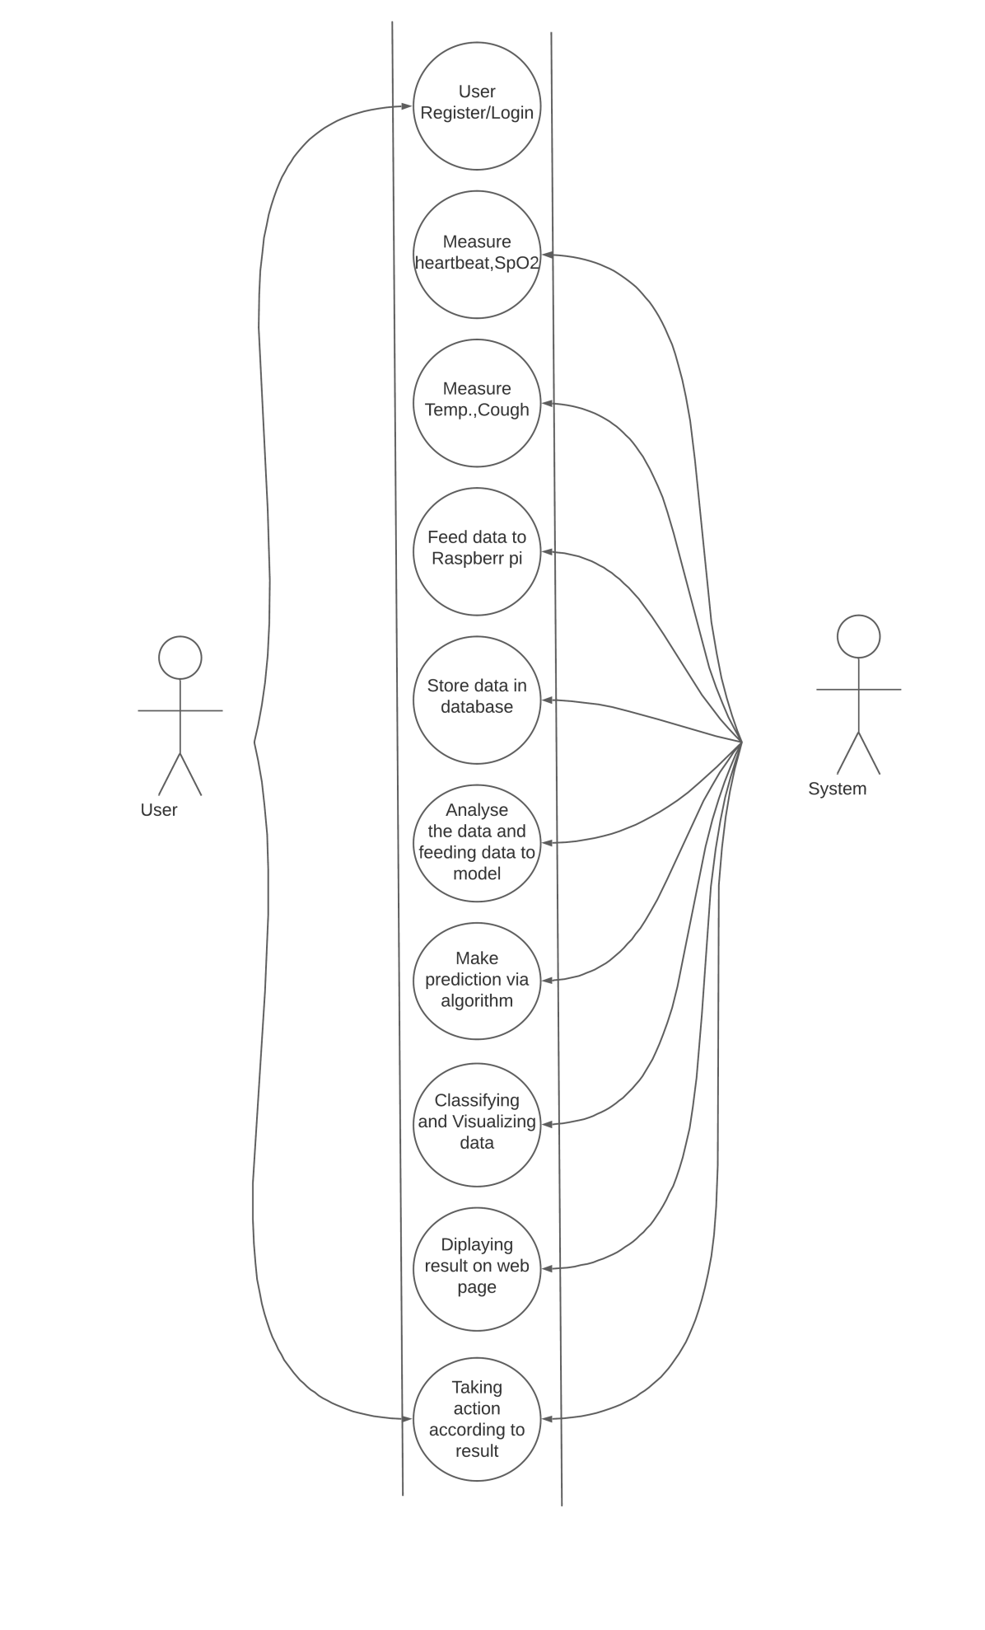
2.3 Use Case

Slide 19
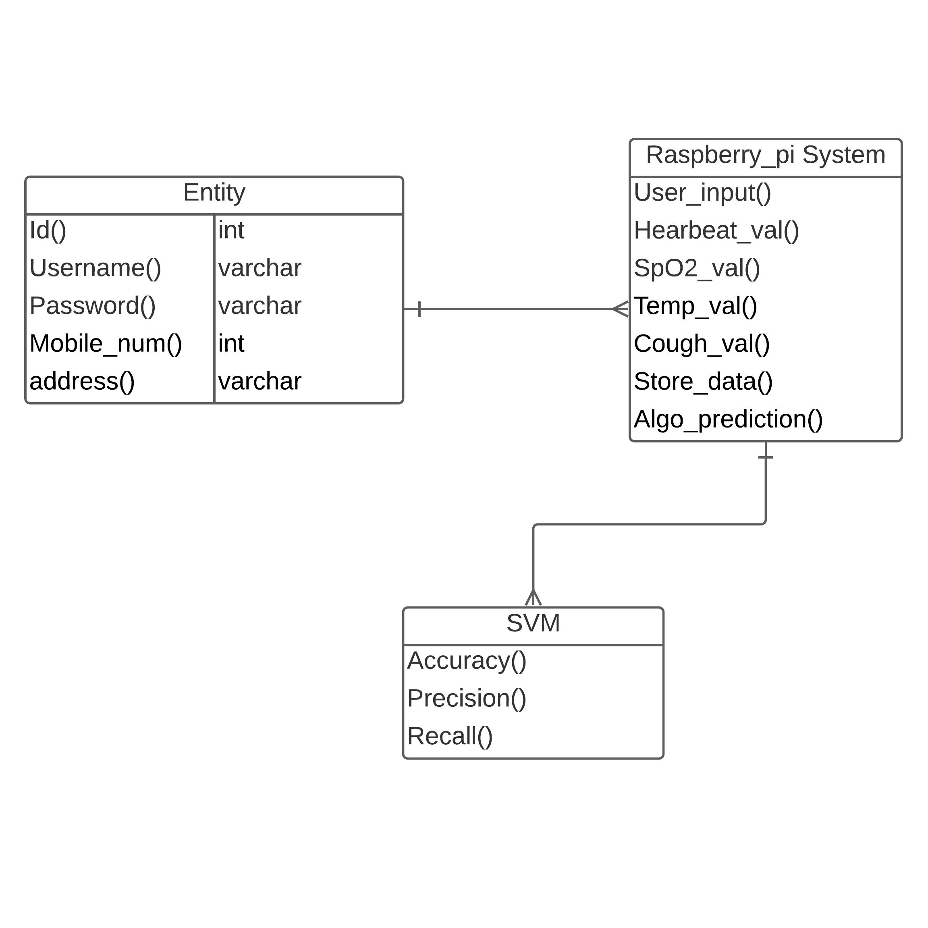
2.4 Class Diagram

Slide 20
3. Implementation

Slide 21
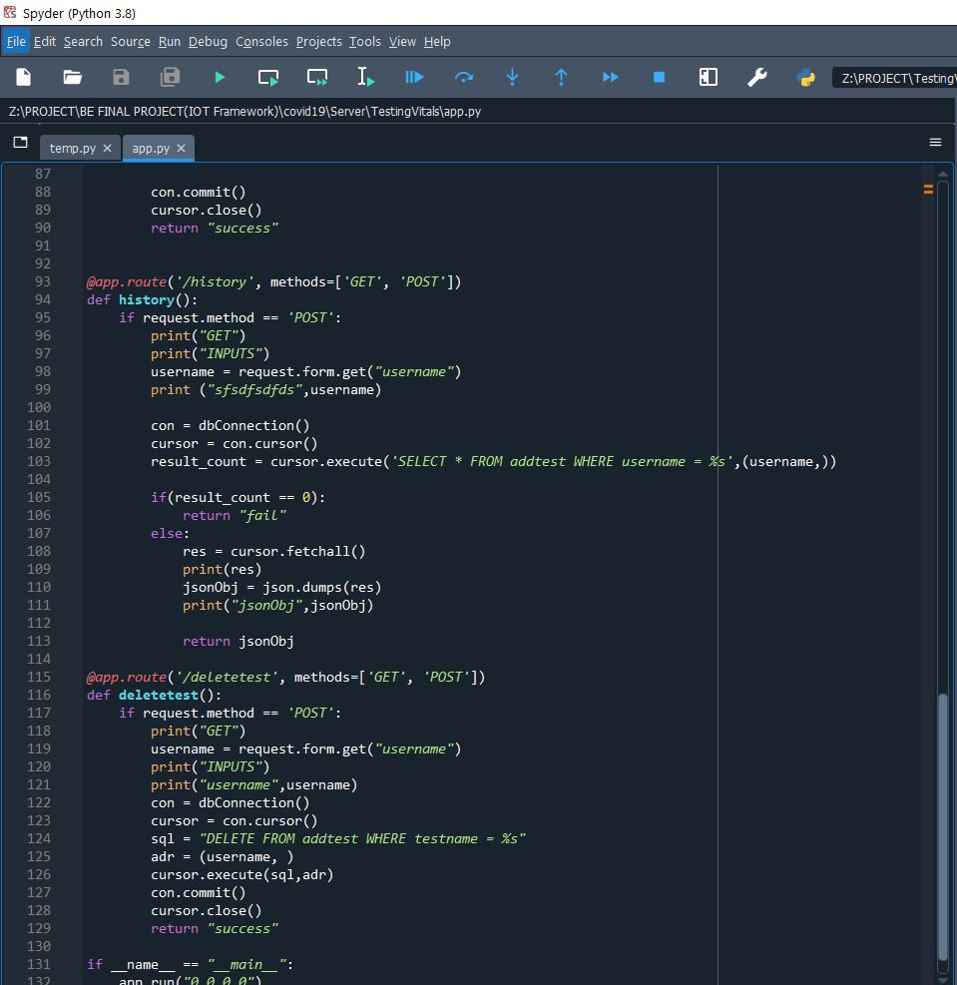
3.1 Application History and Delete Test feature

Slide 22
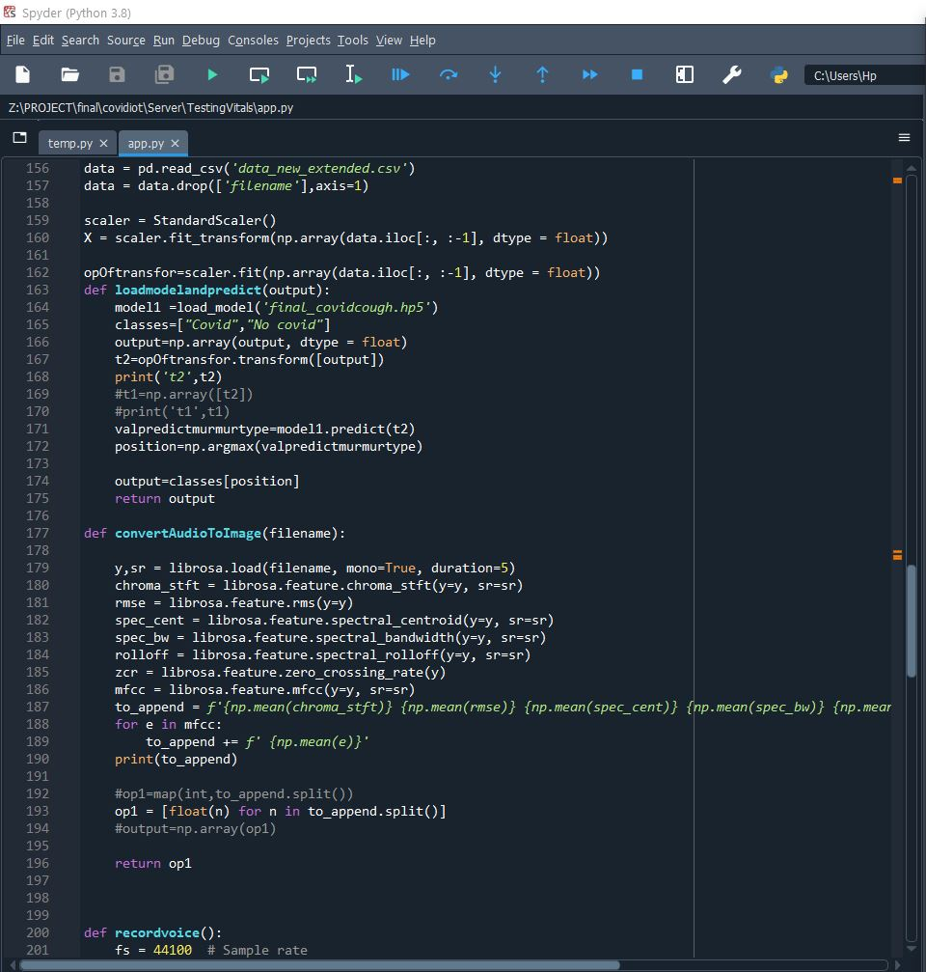
3.2 Vitals Capturing

Slide 23
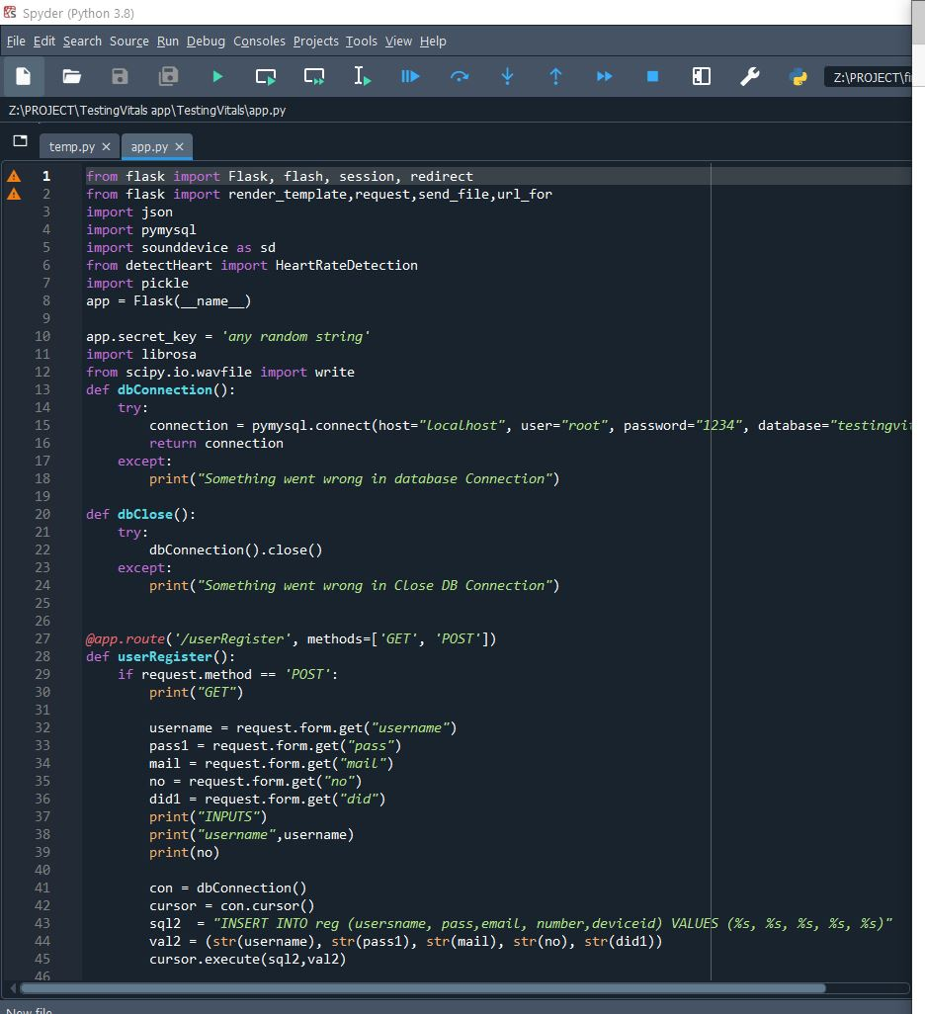
3.3 Website Backend

Slide 24
4. Testing

Slide 25
4.1 Unit Testing
Unit testing is the testing of an individual unit of a software at the code level are functional and work as they were designed.
Testing of each module separately, like the login page, register page, home page, contacts page, add test page, test result page, etc.
All these pages are tested and debugged before going for further integration.
And check whether we are getting the desired output from each module as for the objectives.

Slide 26
4.2 Integration Testing
After each unit is thoroughly tested, it is integrated with other units to create modules or components that are designed to perform specific tasks or activities.
Modules are integrated and checked whether they behave as for the objectives.

Slide 27
5. Result

Slide 28
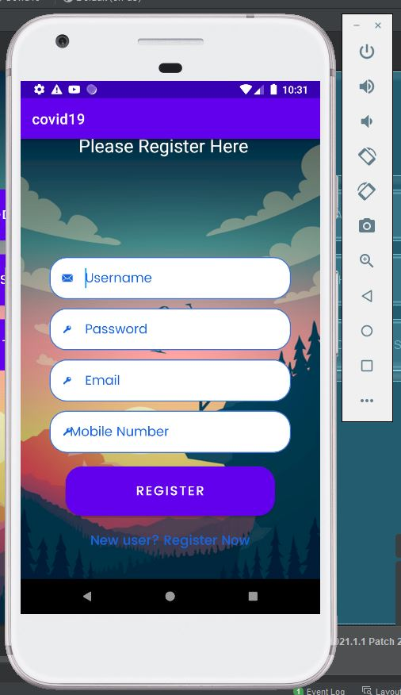
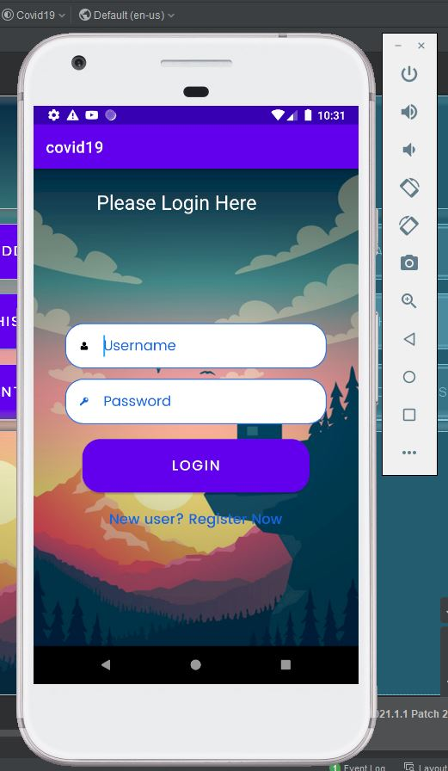
5.1 Login Screen

Slide 29
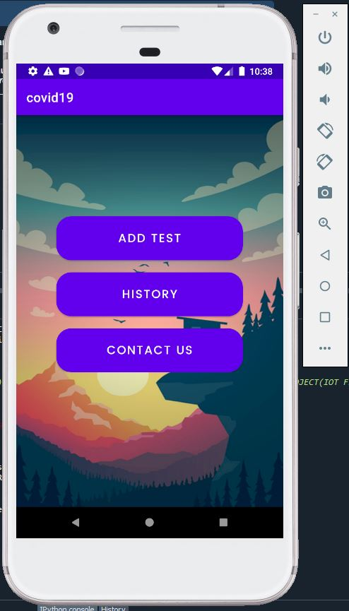
5.2 Home Screen

Slide 30
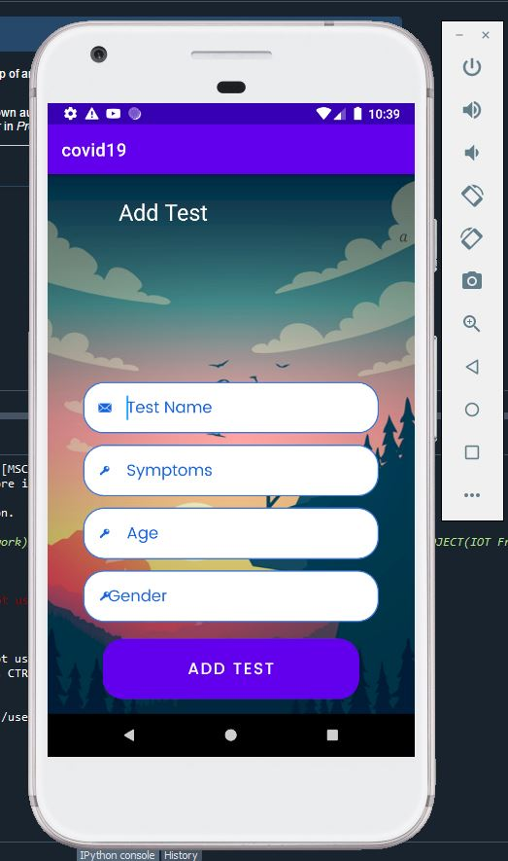
5.3 Add Test Screen

Slide 31
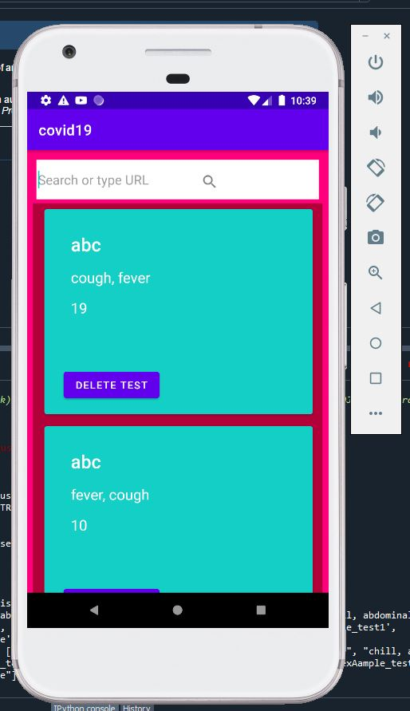
5.4 Test History Screen

Slide 32
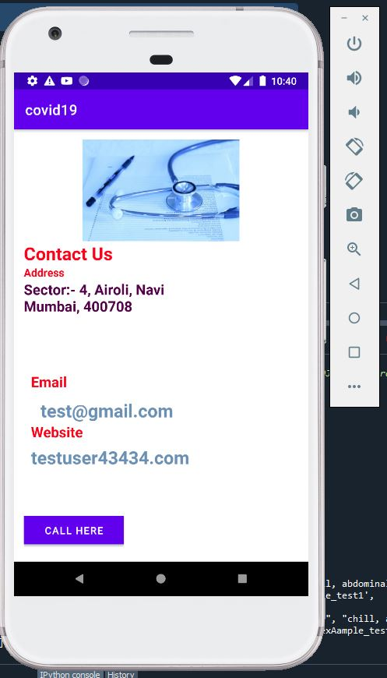
5.5 Contact Screen

Slide 33
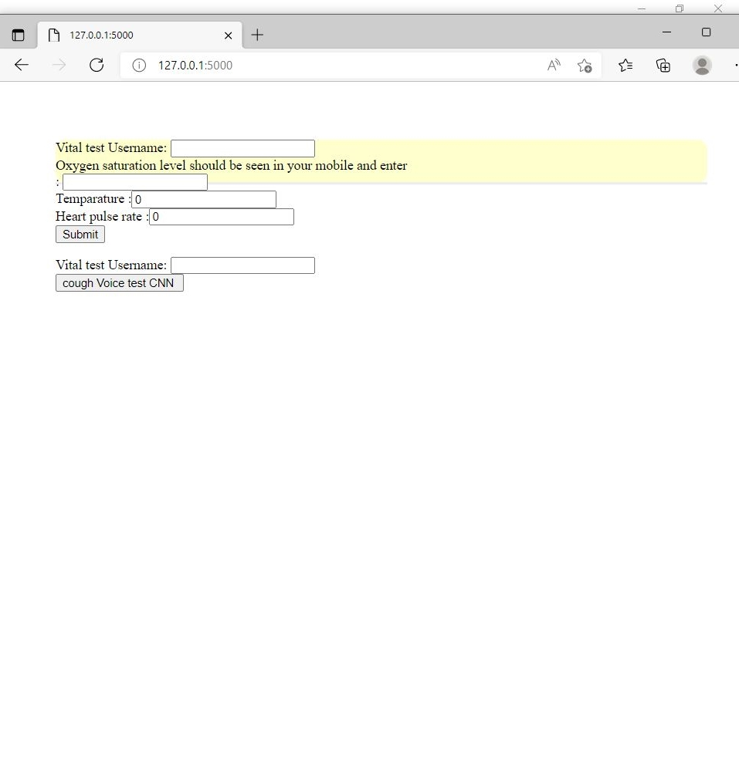
5.6 Vitals Capturing Site

Slide 34
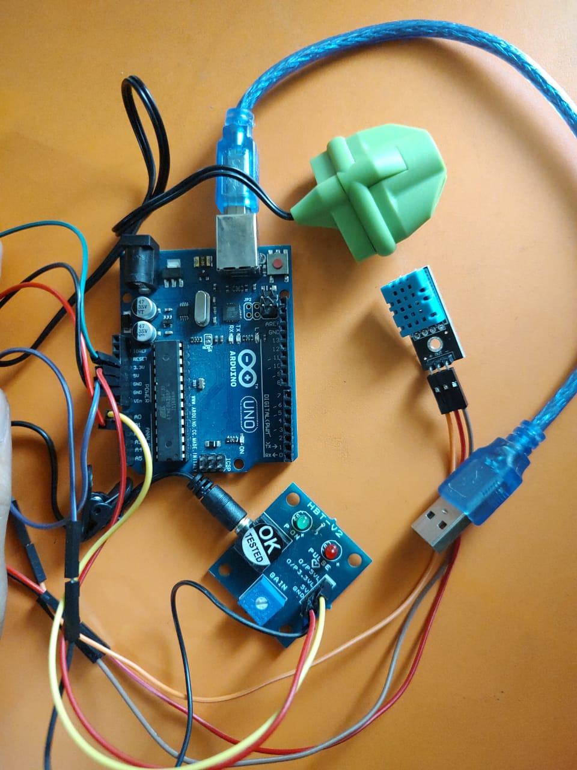
5.7 Hardware Device

Slide 35
6. Conclusion and Future Scope

Slide 36
6.1 Conclusion
As there are many difficulties and dangers associated with its diagnosis of COVID 19, it is preferable to be able to detect the disease using portable devices.
This article has proposed a framework for the remote screening of the virus using the standard practice identified in the literature.
The framework uses sensors made in the form of a wearable device that can be worn by any individual to know in seconds whether the person is healthy or whether they are in doubt to be affected by the disease.
The framework requires testing on a large population and, at the same time, the data obtained from the tests can be used for advanced analyzes such as epidemic forecasting and prevention, population segmentation, as well as to assist the government and policymakers to take appropriate action.

Slide 37
6.2 Future Scope
This project aims to deliver data to the Government and Researchers so that it can take suitable actions according to the analyses done in our project.
We can switch the entire module/setup into a mobile application with the help of IR(InfraRed).
By analyzing the data more , we will come to more accurate results.

Slide 38
References
X. Ding et al., ”Wearable Sensing and Telehealth Technology with Potential Applications in the Coronavirus Pandemic,” in IEEE Reviews in Biomedical Engineering, vol. 14, pp. 48-70, 2021, doi: 10.1109/RBME.2020.2992838.
Ding, Xiaorong and Clifton, David and Ji, Nan and Lovell, Nigel and Bonato, Paolo and Chen, Wei and Yu, Xinge and Xue, Jon and Xiang, Ting and Long, Xi and Xu, Ke and Jiang, Xinyu and Wang, Qi and Yin, Bin and Feng, Guodong and Zhang, Yuanting. (2020). Wearable Sensing and Telehealth Technology with Potential Applications in the Coronavirus Pandemic. IEEE Reviews in Biomedical Engineering. PP. 1-1. 10.1109/RBME.2020.2992838.
Ding, Xiaorong and Clifton, David and Ji, Nan and Lovell, Nigel and Bonato, Paolo and Chen, Wei and Yu, Xinge and Xue, Jon and Xiang, Ting and Long, Xi and Xu, Ke and Jiang, Xinyu and Wang, Qi and Yin, Bin and Feng, Guodong and Zhang, Yuanting. (2020). Wearable Sensing and Telehealth Technology with Potential Applications in the Coronavirus Pandemic. IEEE Reviews in Biomedical Engineering. PP. 1-1. 10.1109/RBME.2020.2992838.

Slide 39
References
Islam, M., Mahmud, S., Muhammad, L.J. et al. Wearable Technology to Assist the Patients Infected with Novel Coronavirus (COVID-19). SN COMPUT. SCI. 1, 320 (2020). https://doi.org/10.1007/s42979-020-00335-4
Fox, K. et al. Heart rate as a prognostic risk factor in patients with coronary artery disease and left-ventricular systolic dysfunction (BEAUTIFUL): a subgroup analysis of a randomised controlled trial. Lancet 372, 817–821 (2008).
Kario, K. et al. The first study comparing a wearable watch-type blood pressure monitor with a conventional ambulatory blood pressure monitor on in-office and out-of-office settings. J. Clin. Hypertens. 22, 135–141 (2020).
Tripathy, A.K.; Mohapatra, A.G.; Mohanty, S.P.; Kougianos, E.; Joshi, A.M.; Das, G. EasyBand: A Wearable for Safety-Aware Mobility During Pandemic Outbreak. IEEE Consum. Electron. Mag. 2020, 9, 57–61.

Slide 40
References
Yamanoor, N.S.; Yamanoor, S. Low-Cost Contact Thermometry for Screening and Monitoring during the COVID-19 Pandemic. In Proceedings of the 2020 IEEE International IOT, Electronics and Mechatronics Conference (IEMTRONICS), Vancouver, BC, Canada, 9–12 September 2020; pp. 1–6.
Zhu, Y.; Chen, L.; Ji, H.; Xi, M.; Fang, Y.; Li, Y. The risk and prevention of novel coronavirus pneumonia infections among inpatients in psychiatric hospitals. Neurosci. Bull. 2020, 36, 299–302.
Tahamtan, A.; Ardebili, A. Real-time RT-PCR in COVID-19 detection: Issues affecting the results. Expert Rev. Mol. Diagn. 2020, 20, 453–454.
Manta, C.; Jain, S.S.; Coravos, A.; Mendelsohn, D.; Izmailova, E.S. An Evaluation of Biometric Monitoring Technologies for Vital Signs in the Era of COVID-19. Clin. Transl. Sci. 2020, 13, 1034–1044.

Slide 41
Paper Publication
Paper entitled “An IOT based framework for Statistical Analysis and Screening of Covid-19 ” is selected and presented at “Third International Conference on Internet of Things organized by SRM Institute of Science and Technology ICIoT-2022” by “Pratik Gholap”, “Apoorva Gadkari” and “Priyanka Walekar”.
Paper entitled “An IOT based framework for Statistical Analysis and Screening of Covid-19” is selected at “Third International Conference on Artificial Intelligence: Advances and Applications ICAIAA-2022” which is a Springer Paper by “Pratik Gholap”, “ Apoorva Gadkari” and “Priyanka Walekar”.
Paper entitled “An IOT based framework for Statistical Analysis and Screening of Covid-19” is selected at “Internet of Things in Modern Computing: Theory and Applications IOT 2022” which is a Springer Paper by “Pratik Gholap”, “Apoorva Gadkari”, and “Priyanka Walekar”.

Slide 42
Thank You

